Slide 1
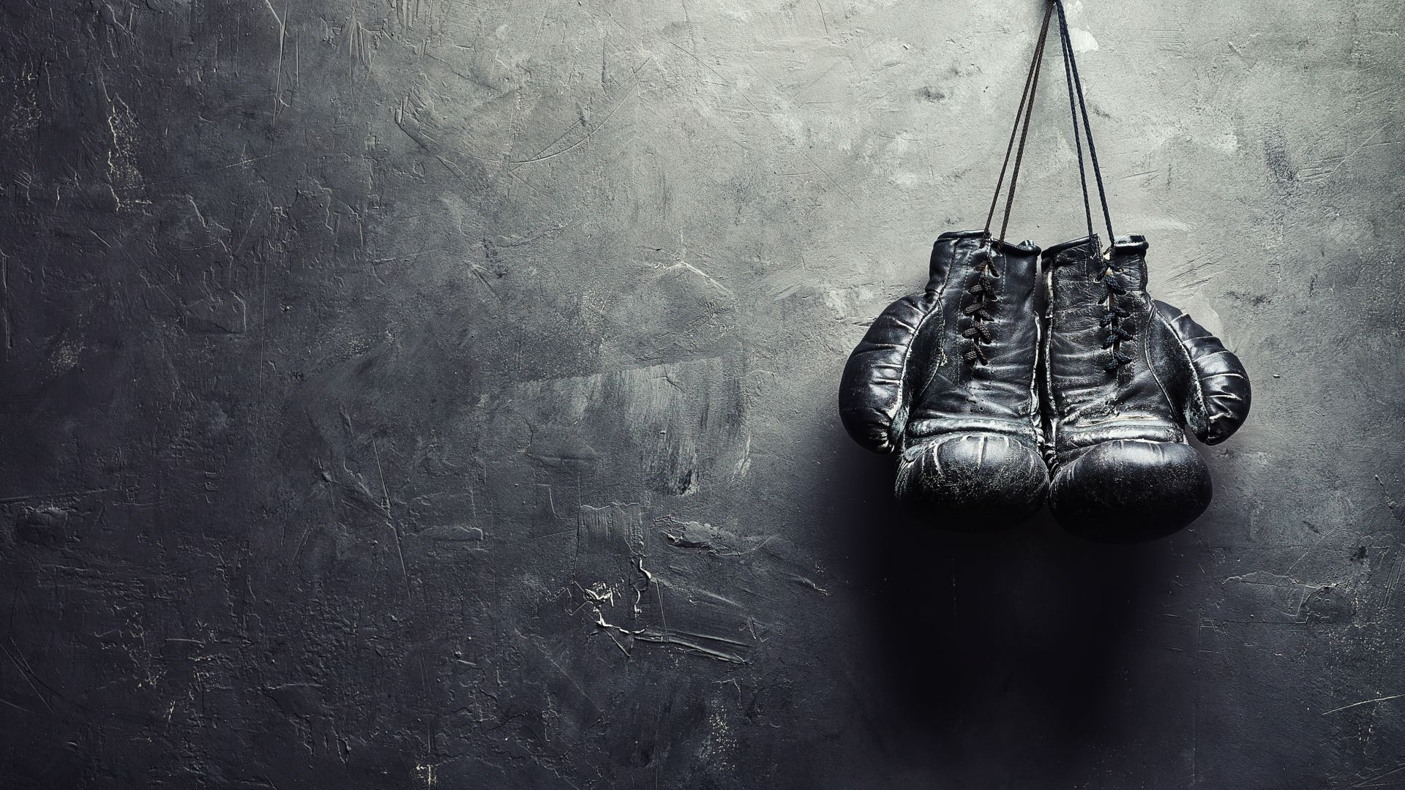
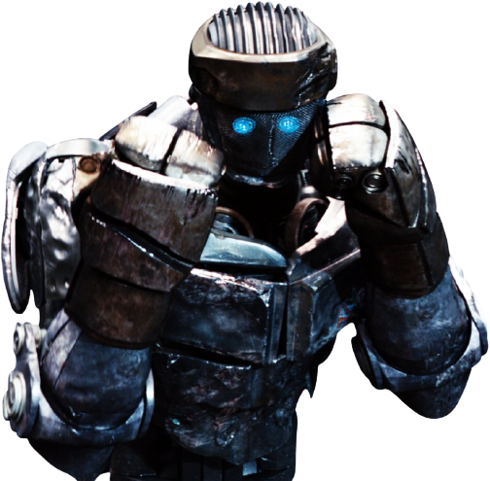
Boxing in the age of AI:
Your RL sparring partner

Slide 2
The current solution does not meet boxers expectations
Problems our users face:
When training alone on a bag or doing shadow boxing is good but you miss about half of the training which requires you adapt to your opponent
Uneven number
Not a strong enough opponent
Paint points of existing robots:
Random movements, not always relevant the the boxer’s moves and behavior
Does not dodge nor not learn from his flaws (once the boxers finds a way to defeat the robot, the robot never adjusts)

Slide 3
Technical description of the agent
Agent: Bob-like dummy robot (bob = existing punching dummy)
environment: everywhere, focus on the gloves with identification
states: Users hands position with respect to its body parts that are targets (head, shoulders, chest….)
actions: Hit on the optimal body part/ protect given the users actions
rewards: Different rewards depending on where the robot hits. negative rewards when hit by user

Slide 4
This solution could lead to a revolution in the boxing industry who hasn’t evolved for decades
self training at home
best training for professionals
for boxing clubs in case of uneven number of participants
Example : 6.5M boxers in the US in 2017 (source: Statista) → huge market
In France, number of licensed boxers doubled in the last 10 years (30k -> 60k)

Slide 5
Our solution would look like
Agent (physical robot)
Camera for identification of the gloves
Force sensors on the robot
- Gloves :
- Easily seen on camera with flash color and

